Slide 1


VISUAL LEARNERS
AUGUST
22, 2022
YOLO
SERIES

Slide 2
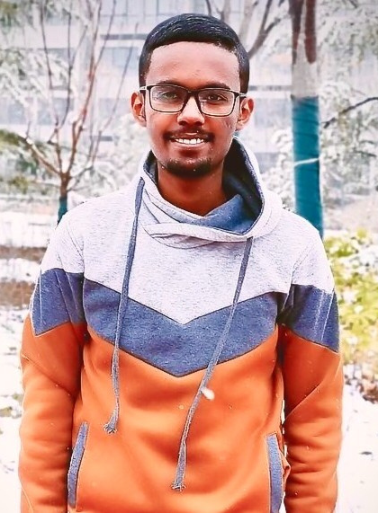
August
22, 2022
Presented by
Teddy Tassew
Introduction
Let me say a little bit about myself

Slide 3
Self Introduction
November
22, 2022
Presented by
Teddy Tassew
My Educational Background
My name is Tewodros (Teddy) Tassew. I I am currently in my 2nd year masters students studying software engineering at Northwestern Polytechnical University in Xian, China. I mostly work on utilizing object detection and segmentation algorithms for medical diagnosis.

Slide 4
VISUAL LEARNERS
August
22, 2022
Presented by
Teddy Tassew
The goal of this series is to help you learn the theoretical background and evolution of one of the most commonly used real time object detector called YOLO.

Slide 5
VISUAL LEARNERS
August
22, 2022
Presented by
Teddy Tassew
The reason that I created this series is because there aren't a lot of resources out there to teach about YOLO and if there are, they are they are mostly spread out.

Slide 6



VISUAL LEARNERS
August
22, 2022
Presented by
Teddy Tassew
Contents
01.
02.
03.
Basic Concepts
Metrics
YOLO Family

Slide 7

VISUAL LEARNERS
August
22, 2022
Presented by
Teddy Tassew
HOPE YOU HAVE A GREAT LEARNING EXPERIENCE

